Slide 1
Sulzer Senior Software Developer
Case studies

Slide 2
The case study
The case study will test you in the following areas:
Architecture & Security
Problem solving & Coding skills
Communication and Logical Thinking is evaluated in addition to the results.

Slide 3
Case Study 1 - Architecture & Security
Case Study 1 - Architecture & Security
You are the technical responsible to come up with a solution architecture for an data and adv. analytics web application using Azure Cloud services and Containers. This is a very early stage solution architecture with limited requirements so assumptions are expected with motivation.
High level requirements:
- The solution must be capable of ingesting and transforming data quickly within 2 minute and a size of data up to 100 MB.
- The solution must be scalable and multitenant
- The user expects a Web based interface and API interface for both uploading and downloading data
- The solution should use the Azure B2C for authentication
- The solution should at idle state not cost more than 30k USD per year
- The solution should be possible to build with no more than 3 resources

Slide 4
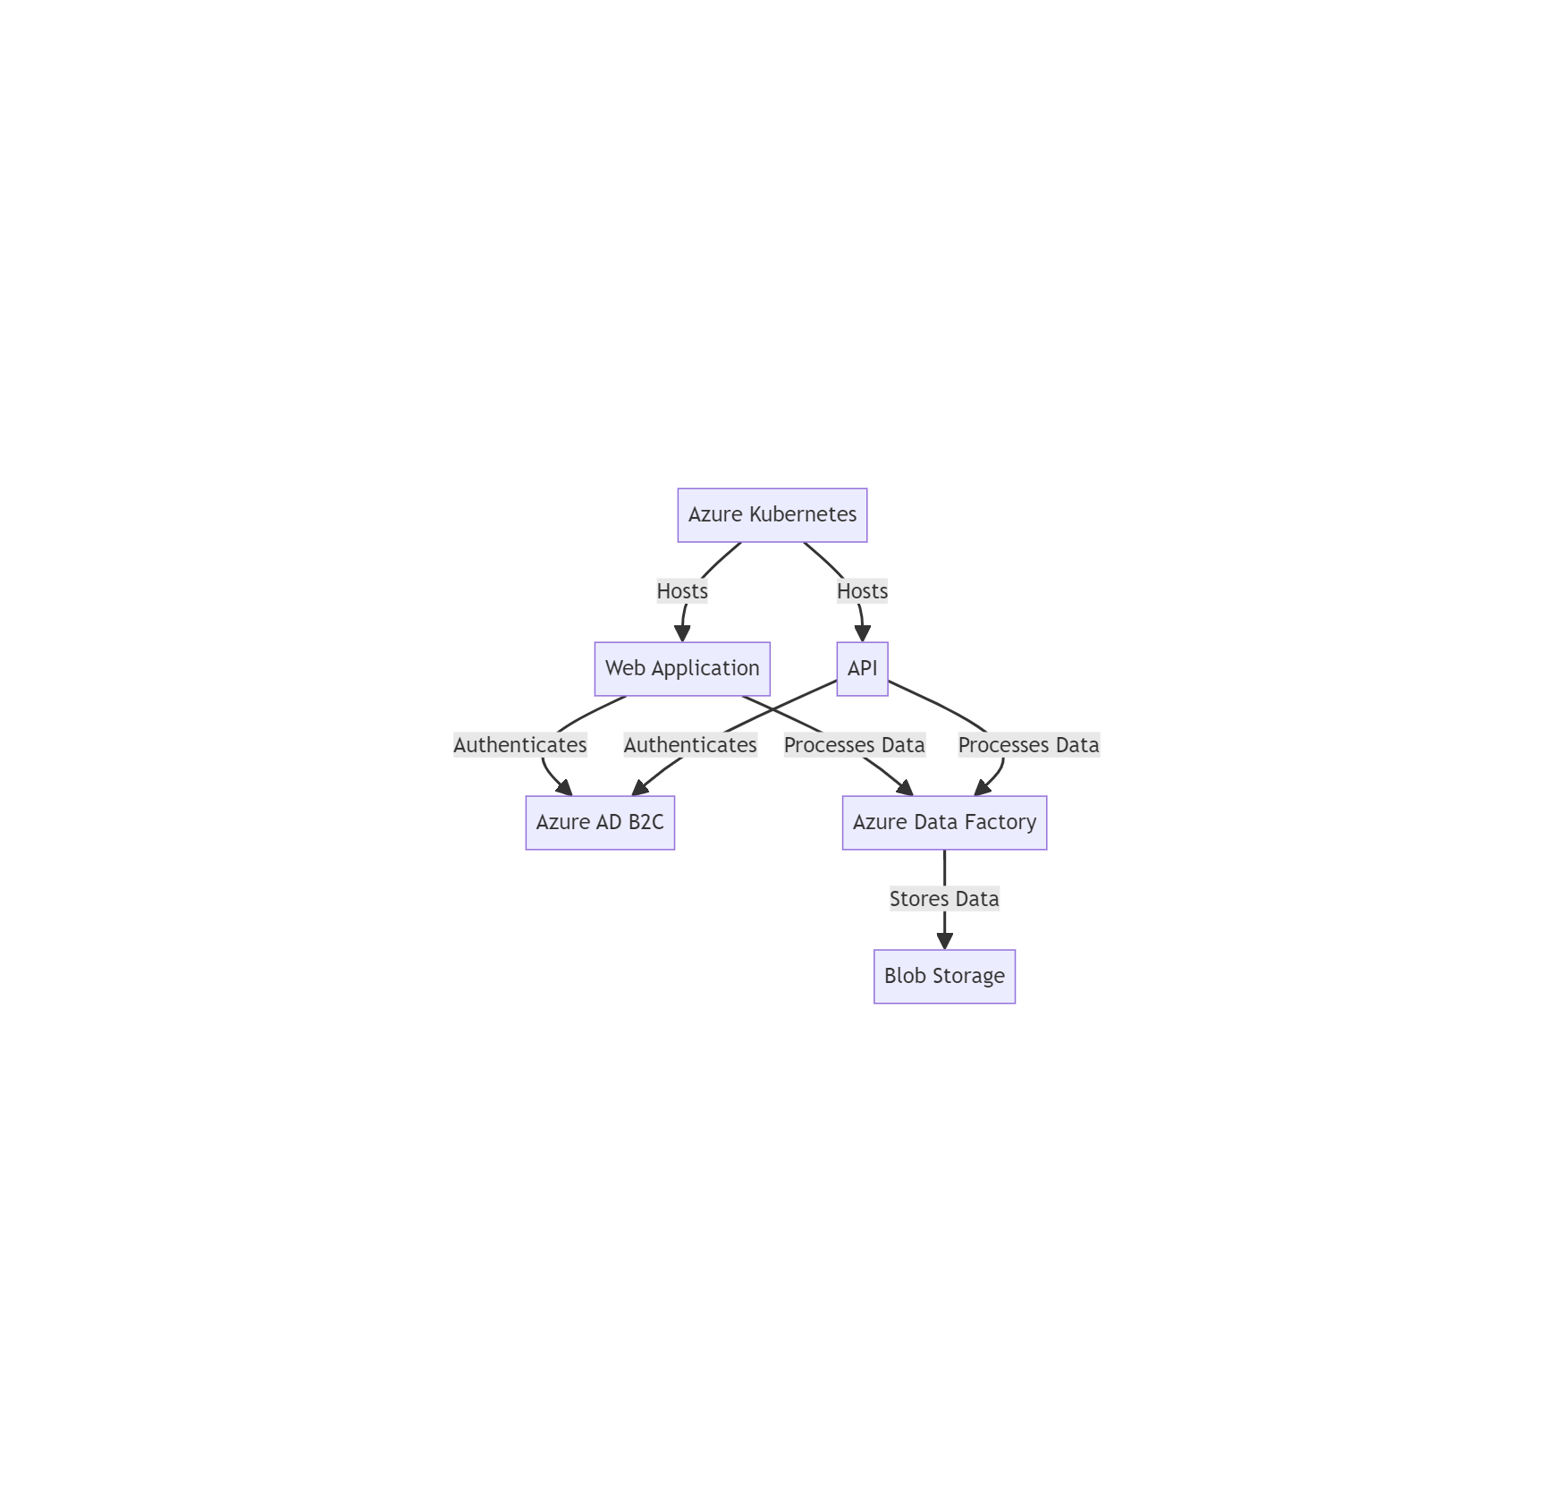
Data & Analytics Solution Architecture
Diagram source
Solution Overview
Fast data ingestion and transformation (Azure Data Factory)
Scalability and multi-tenancy (AKS) Web and API interfaces (containerized application in AKS)
Azure B2C for authentication
Cost-effective (under $30k per year)
Uses only 3 main resources (for starting)

Slide 5
Data & Analytics Solution Architecture
Diagram source
Solution Overview
Azure Kubernetes Service (AKS)
Azure Blob Storage
Azure Data Factory
Azure B2C for authentication

Slide 6
Data & Analytics Solution Architecture
Diagram source
Solution Overview
Azure Kubernetes Service (AKS)
- Hosts the containerized web application and API
- Provides scalability and multi-tenancy support
- Allows for quick scaling based on demand
Azure Blob Storage
- Stores incoming and processed data
- Provides low-cost, scalable storage
- Supports both upload and download operations
Azure Data Factory
- Handles data ingestion and transformation
- Can process data quickly (within 2 minutes for 100 MB)
- Supports various data sources and destinations
Azure B2C for authentication

Slide 7

Key Features
- Fast data ingestion and transformation
- Scalable and multi-tenant
- Web and API interfaces
- Secure authentication
- Cost-effectiveness

Slide 8
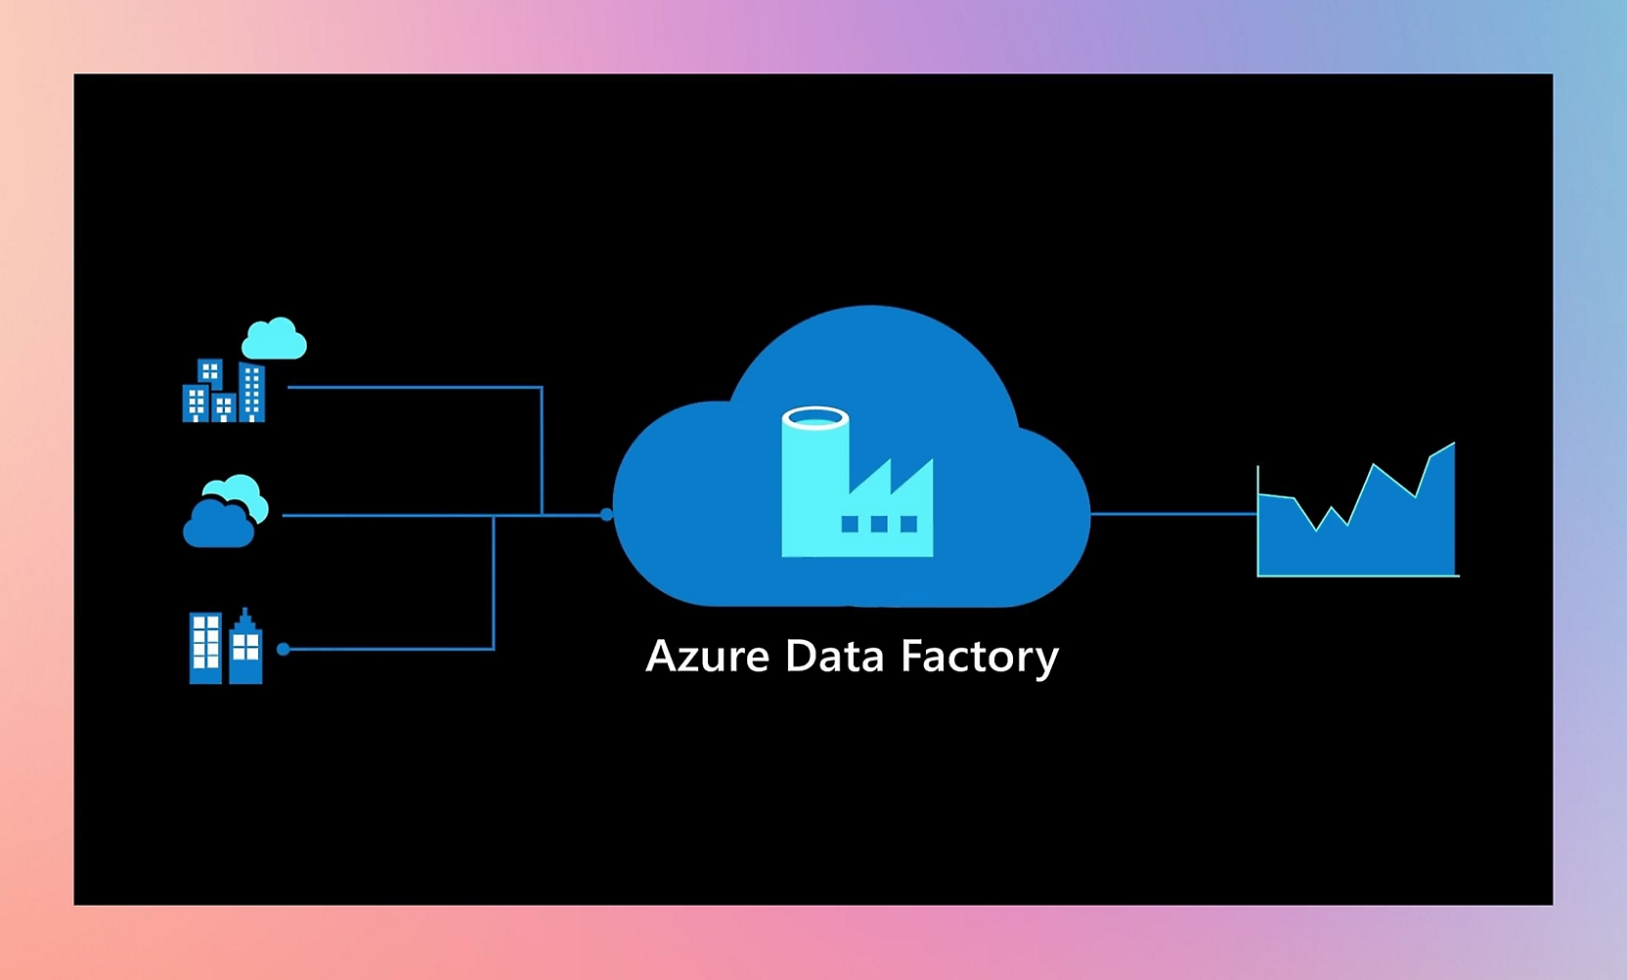
Key Features
- Fast data ingestion and transformation
Azure Data Factory Scalability
Scales by increasing the number of activity runs per day.
We scale from 100 to 500, then to 1000 runs per day.
This allows for processing more data and handling more complex data pipelines.

Slide 9

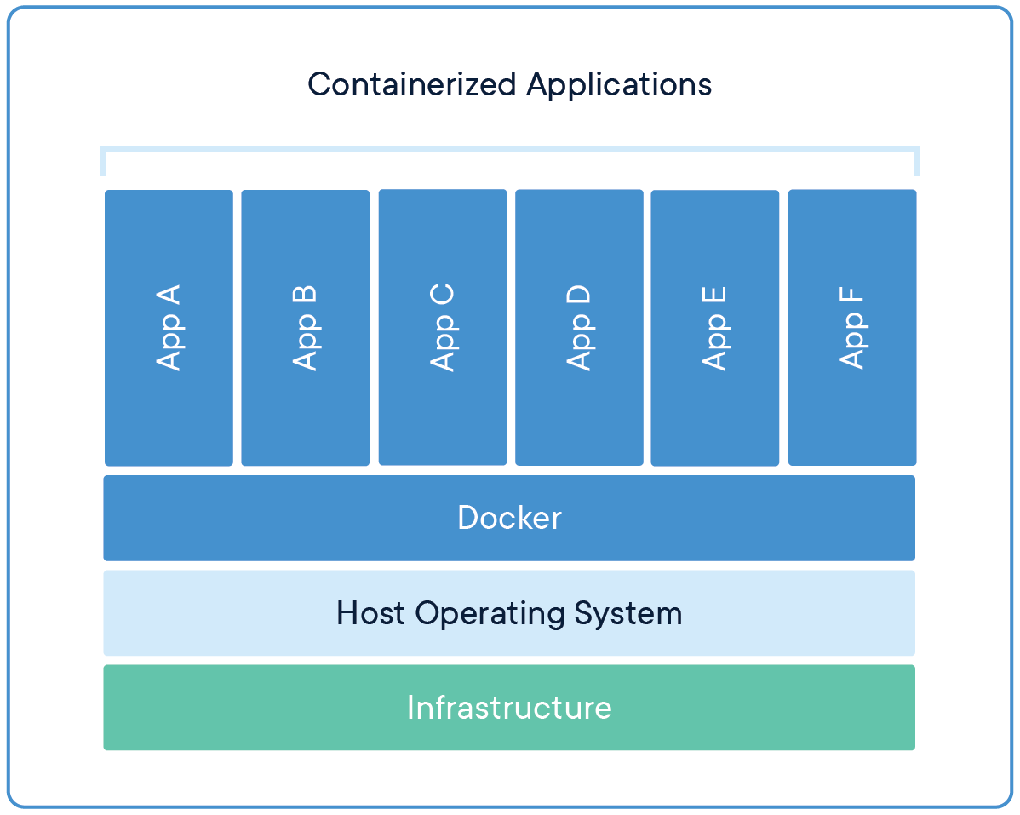
Key Features
- Scalable and multi-tenant
- Web and API interfaces
Kubernetes AKS Scalability:
Scales by adding more nodes to the cluster.
In this example, we scale from 1 node to 3 nodes, then to 5 nodes.
This increases compute power and ability to handle more concurrent users and workloads.

Slide 10
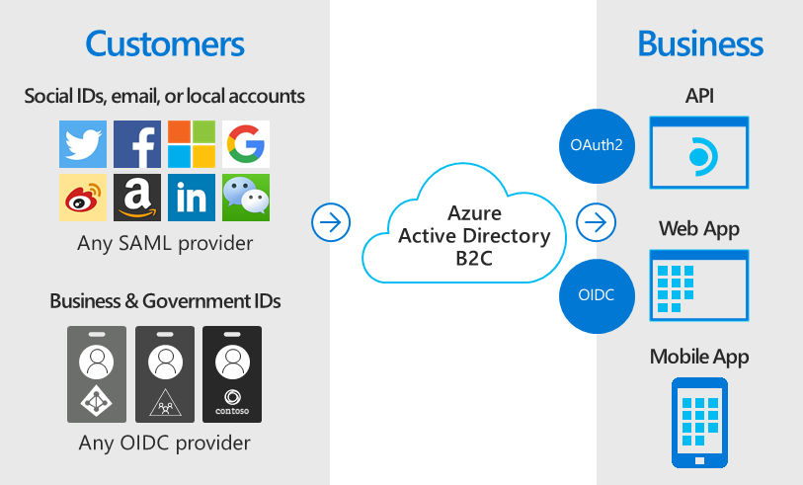
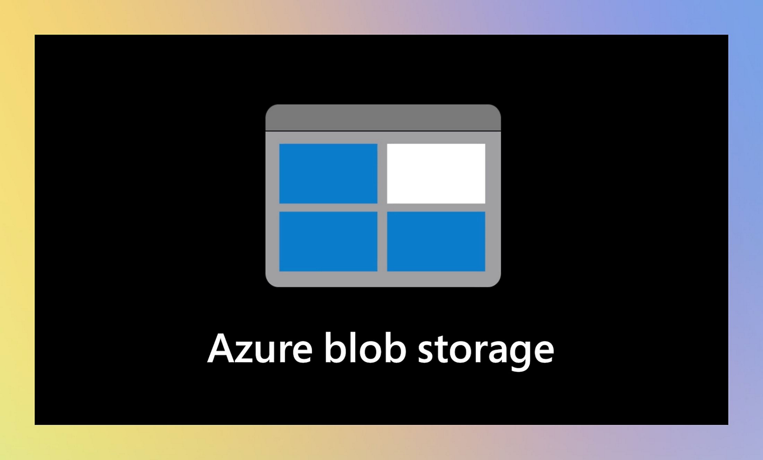
Key Features
- Secure authentication
- Cost-effective
Azure B2C Scalability: Scales by increasing the number of Monthly Active Users (MAU).
Can scale from 50,000 to 100,000, then to 200,000 MAU.
This allows for authenticating more users as the application's user base grows.
Blob Storage Scalability: Scales by increasing storage capacity.
Can scale from 1 TB to 5 TB, then to 10 TB.
This allows for storing more data as the application grows.

Slide 11
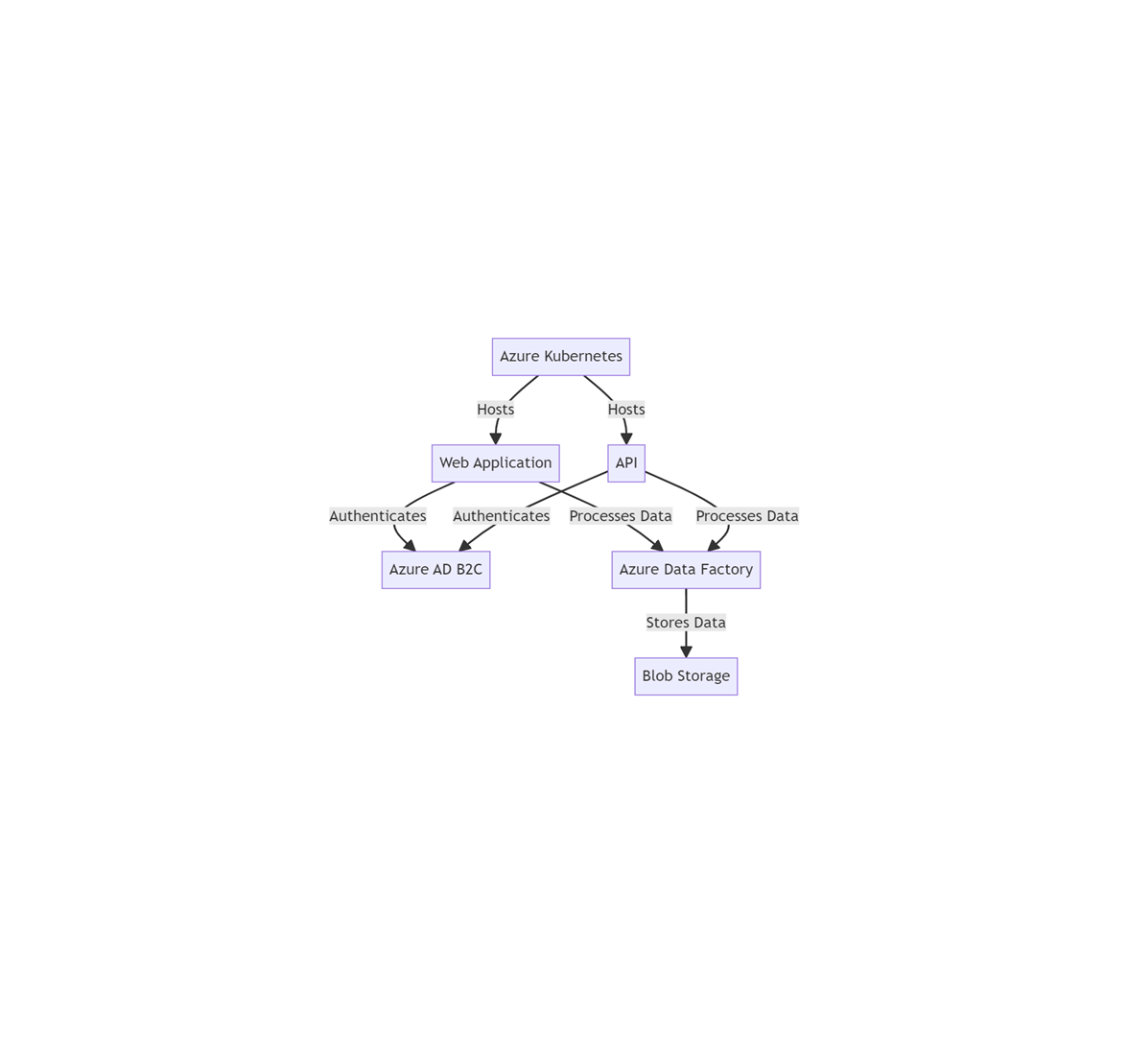
Initial Scenario
Basic spent
1. Azure Kubernetes Service (AKS)
- Hosts containerized web app and API
- Provides scalability and multi-tenancy
2. Azure Blob Storage
- Stores incoming and processed data
- Low-cost, scalable storage
3. Azure Data Factory
- Handles data ingestion and transformation
- Processes data within 2 minutes (up to 100 MB)

Slide 12
Initial Scenario
Variable spent
1. Azure Kubernetes Service (AKS)
2. Azure Blob Storage
3. Azure Data Factory
4. Azure B2C
5. Azure SQL DB
PowerBI Subscription/Advance Analysis Tools for Graphical Data Analysis and Reporting

Slide 13
Initial Scenario
Variable spent
Service | Details | Suma de Annual Cost
Azure B2C | 200,000 MAU | $ 7,800.00
 | 100,000 MAU | $ 3,900.00
 | 50,000 MAU | $ 1,950.00
Total Azure B2C |  | $ 13,650.00
AKS | 5 nodes, D2 v2 (2 vCPUs, 7 GB) | $ 4,380.00
 | 3 node, D2 v2 (2 vCPUs, 7 GB) | $ 2,628.00
 | 1 node, D2 v2 (2 vCPUs, 7 GB) | $ 876.00
Total AKS |  | $ 7,884.00
Azure SQL DB | Premium tier, 125 DTUs | $ 2,743.32
 | Standard tier, 50 DTU | $ 887.64
 | Basic tier, 5 DTUs | $ 58.80
Total Azure SQL DB |  | $ 3,689.76
Blob Storage | 10 TB | $ 2,260.80
 | 5 TB | $ 1,130.40
 | 1 TB | $ 226.08
Total Blob Storage |  | $ 3,617.28
Data Factory | 1000 activity runs/day | $ 360.00
 | 500 activity runs/day | $ 180.00
 | 100 activity runs/day | $ 36.00
Total Data Factory |  | $ 576.00
Total general |  | $ 29,417.04

Slide 14
Initial Scenario
Variable spent

Slide 15
Extension with Power BI and Azure Data Fabric
To extend the solution for further and deeper analysis, we can integrate Power BI and Azure Synapse Analytics (part of Azure Data Fabric):
- Power BI:
- Provides advanced data visualization and reporting capabilities
- Can connect directly to Azure Blob Storage for data analysis
- Enables self-service BI for end-users
- Azure Synapse Analytics:
- Offers a unified experience for data integration, enterprise data warehousing, and big data analytics
- Can ingest data from Azure Blob Storage and provide advanced analytics capabilities
- Supports both SQL and Spark engines for diverse analytical needs

Slide 16
Motivations and posibilities
Architecture Overview: This solution focuses on Azure Cloud Services, which are optimized for cost-efficiency, while maintaining scalability and performance for the Bluebox platform.
Data Ingestion & Transformation:
Use Azure Functions for serverless, event-driven computation to process the incoming data.
A combination of Azure Event Hub or Azure Blob Storage to handle data ingestion (depending on whether it's event-based or batch-uploaded data).
For the transformation (ETL), Azure Data Factory can handle data orchestration and transformation logic.

Slide 17
Motivations and posibilities
Architecture Overview: This solution focuses on Azure Cloud Services, which are optimized for cost-efficiency, while maintaining scalability and performance for the Bluebox platform.
Multitenancy and Scalability:
Use Azure Kubernetes Service (AKS) to host a containerized environment for the web and API interfaces, allowing dynamic scaling.
Azure Cosmos DB or Azure SQL Database for multi-tenant data storage, ensuring database scalability across clients.

Slide 18
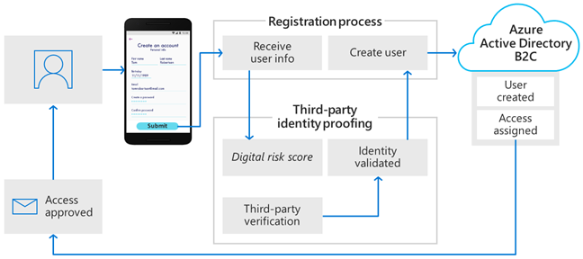
Motivations and posibilities
Architecture Overview: This solution focuses on Azure Cloud Services, which are optimized for cost-efficiency, while maintaining scalability and performance for the Bluebox platform.
User Interface (Web and API):
Develop the web-based UI using React.js or Angular and host it on Azure App Service.
REST APIs for uploading and downloading data will also be hosted on the same App Service or AKS cluster.

Slide 19
Motivations and posibilities
Authentication:
Leverage Azure AD B2C for customer identity and access management, ensuring secure authentication for end users.
Cost management:
Ensure the solution's idle state cost does not exceed $30k/year with cost-efficient services like Azure Functions (which bill based on usage) and container-based workloads (AKS) which scale down when not in use.
Architecture Overview: This solution focuses on Azure Cloud Services, which are optimized for cost-efficiency, while maintaining scalability and performance for the Bluebox platform.

Slide 20

Adaptability and Flexibility
By learning to adjust to change and embracing new challenges, we can develop the resilience and resourcefulness necessary for success in entrepreneurship, leadership, and beyond.

Slide 21

Jaime Gibertoni
Thank you very much for your time

Slide 22
Adaptability and Flexibility
IoT for Real-time Pump Monitoring:
IoT Hub Integration:
Azure IoT Hub could be incorporated to collect real-time data from sensors on pumps. These IoT devices will transmit performance metrics (e.g., pressure, flow rate, temperature) and health status to the platform.
This allows the Bluebox system to remotely monitor pumps (water, oil, and other types of fluid pumps), identify any anomalies early, and potentially send commands back to the devices for adjustments.

Slide 23
Case Study 2 – Coding Skills
You are tasked with building a system that processes customer orders. Each order contains multiple items, and each item has a price. Some items may have discounts applied to them based on certain rules. Your task is to implement a function that calculates the total price of an order after applying the appropriate discounts.
Basic Item Structure:
An order consists of multiple items.
Each item has:
Name
Quantity
Unit price
Input example:
var order = new List<Item> {
new Item("Laptop", 1, 1000.00m),
new Item("Mouse", 3, 25.00m),
new Item("Keyboard", 2, 50.00m)
};
Discounts:
If the customer buys 3 or more units of the same item, they get 10% off on that item.
If the total price of the order before applying any discount exceeds $100, apply a 5% discount on the entire order.
Explanation:
The Laptop has no discount because it’s only 1 unit, total price = $1000.
The Mouse qualifies for the 10% discount (since there are 3 units), so the total for 3 mice = $25 * 3 = $75 - 10% = $67.50.
The Keyboard has no discount because it’s only 2 units, total price = $50 * 2 = $100.
The total price before the bulk order discount is $1000 + $67.50 + $100 = $1167.50.
Since the total is above $100, a 5% discount is applied to the entire order: $1167.50 - 5% = $1109.12.
Output:
The function should return a value representing the total price of the order after applying discounts.

Slide 24
Case Study 2 – Coding Skills
Constraints:
You cannot use any external libraries for handling discounts.
Focus on code readability, performance, and correctness.
Evaluation Criteria:
Correctness: The function should accurately calculate the total order price.
Code Efficiency: The solution should handle larger orders efficiently.
Readability: The code should be clean, modular, and easy to follow.
Edge Cases: Consider cases where:
No items are in the order.
All items have discounts.
The total price is exactly $100.
The deliverable must be a running piece of code

Slide 25
Case Study 3 – Problem Solving
You are tasked with building a flight route planner for a fictional airline company. This planner will help customers find the cheapest route between two cities based on a complex dynamic pricing system.The airline operates between several cities, but flight prices are dynamic and depend on various factors, such as the time of booking, distance, availability, and special offers.
Requirements:
Graph Representation:
Each city is a node.
Each flight is an edge with a weight representing the current price.
The weight (price) between any two cities is dynamic, meaning it can change with time.
Dynamic Pricing System:
Prices fluctuate based on:
Time of day (peak/off-peak hours).
Availability (more expensive when fewer seats are left).
Distance between cities.
Special discounts or promotions applied periodically.
Route Planner:
The user can request the cheapest route between two cities. Your algorithm should handle:
Single flight trips.
Multi-leg trips (trips with multiple connecting flights).
The system should respond quickly, even when prices dynamically change during the day.
Additional Features:
The system should support round-trip planning with dynamic pricing on both legs of the trip.
Allow queries with constraints such as:
Max number of connections.
Flight duration limits (some flights take longer, e.g., layovers).
Efficiency:
The system should handle large datasets with up to 1,000 cities and 10,000 possible flight routes.
Consider using advanced data structures such as priority queues or Fibonacci heaps for faster lookups and updates.

Slide 26
Case Study 3 – Problem Solving
Example list of cities and possible flights:
City_A, City_B, Distance = 500 km
City_B, City_C, Distance = 300 km
City_A, City_C, Distance = 800 km
Pricing function logic:
price = base_price + dynamic_factor
base_price = Distance * 0.1 (e.g., $0.10 per km)
dynamic_factor = f(time, availability, promotions)
User queries:
Find the cheapest route from City_A to City_C
Find a round-trip from City_A to City_B with at most one connection.
User queries:
Find the cheapest route from City_A to City_C
Find a round-trip from City_A to City_B with at most one connection.
The deliverable must be a running piece of code

